Slide 1
GITHUB COPILOT
Welcome
Training Agenda
for Software Engineers
Introduction
Notes:
Welcome to the MS GitHub Copilot training which is part of the Capgemini GenAI Campus offering.

Slide 2
Welcome

Slide 3

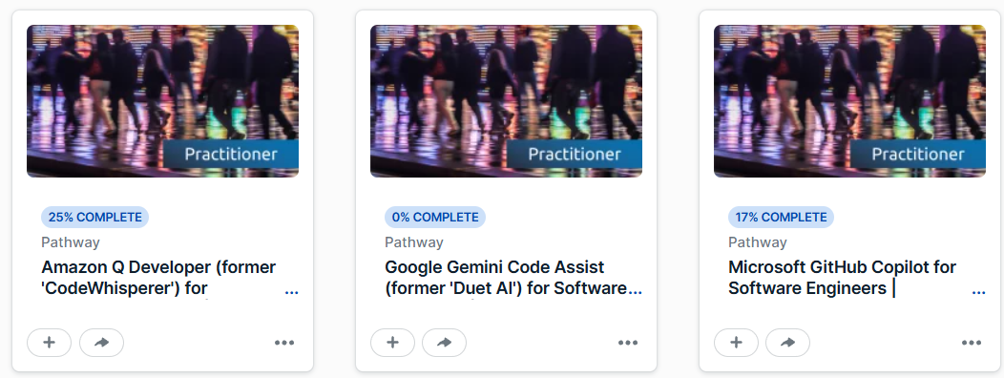

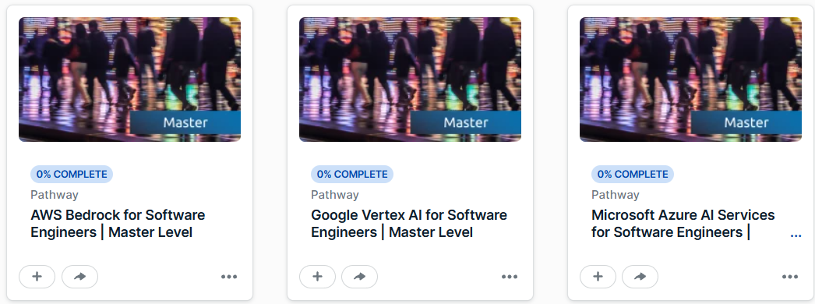
Welcome to the GenAI campus training for Microsoft GitHub Copilot
The Capgemini Generative AI Campus is happy to propose you a set of consistent training on this technology
More content available on the
Generative AI Campus
Notes:
This course focusses on MS GitHub Copilot which is the category of the Coding Assistant.
Beside this course, Capgemini invested massively in Gen-AI trainings, covering multiple levels of maturity, allowing our employees to get the benefit of Gen-AI in the context of our delivery.
You can find more Generative AI training content at our Training Portal “Next” by visiting the Generative AI Campus homepage.

Slide 4
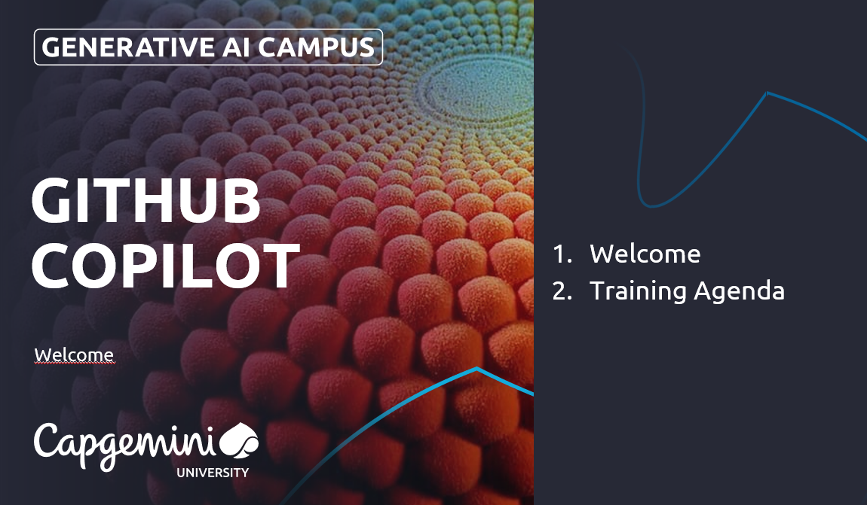

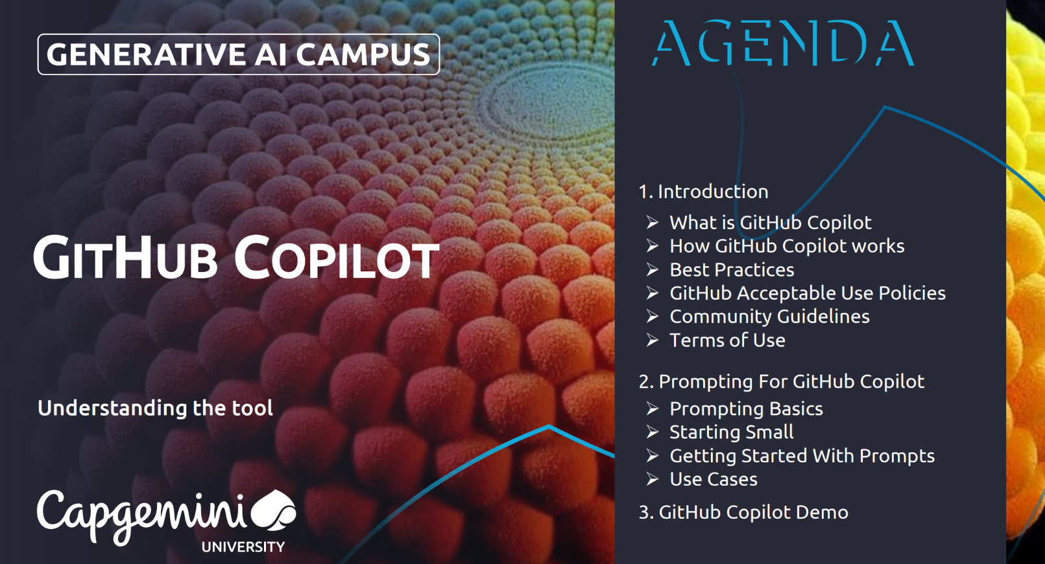
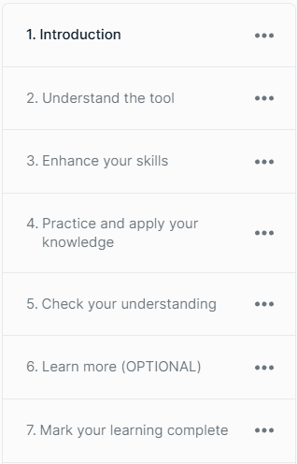






Training agenda
8 min
7 min
Mandatory
Mandatory
Mandatory
+
New features demo videos and articles
2h 13 min
Mandatory
Hands-on training based on scripts
1h 40 min
Knowledge check (2 parts)
8min
Mandatory
Optional
Mandatory
Mark your learning complete
Notes:
This training is part of a series of trainings offered by the GenAI Campus, developed in collaboration with the C&CA teams. It is calibrated for a duration of approximately two and a half hours excluding practical exercises.
You are watching the “Introduction” right now, focusing on a general presentation of MS GitHub Copilot, covering its features, benefits, technologies, and legal risks.
Next, “Understand the tool”, will show you how you can use MS GitHub Copilot to accelerate your coding activities.
In “Enhance your skills”, you will learn about best practices in the way to interact with the AI code assistant.
“Integrate Gen AI in your work”, designed by our C&CA team, enables you to use Gen-AI within the whole Software Delivery Lifecycle.
If you own a MS GitHub Copilot license, you can follow “Practice and apply your knowledge and skills”, to practice your learnings on practical examples.
Finally, we’ll provide a questionnaire to validate your Gen-AI knowledge.

